Slide 1

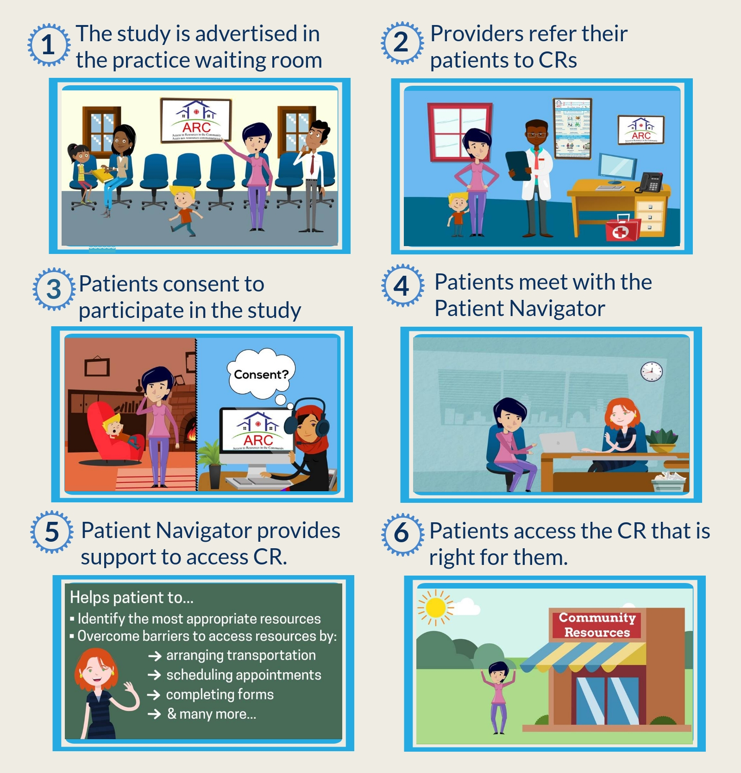










Evaluating the Introduction of a Patient Navigator in Primary Care Practices: A Mixed Methods Approach
Perna A¹, Chiocchio F² , Gauthier A P³, Prud'homme D⁶, Lemonde M⁵, Presseau J ^{2,4}, Kendall C,^{1,2} Toal-Sullivan D¹, Dahrouge S¹ ²
¹Bruyère Research Institute, ²University of Ottawa, ³Laurentian University, ⁴Ottawa Hospital Research Institute, ⁵University of Ontario Institute of Technology, ⁶L'Institut de recherche de l’hôpital Montfort
Acknowledgements: IMPACT executive team – Jeannie Haggerty, Cathy Scott, Grant Russell, Mark Harris, Virginia Lewis, Nigel Stock, Jean Frederic Levesque, Simone Dahrouge
Background
Feasibility Outcome Measures, Tools & Analysis
Study Process
Community based health and social resources that can help individuals achieve their health goals are underutilized.
Lack of provider and patient awareness of community resources (CR)* and barriers in access contribute to low utilization.
Very little is known about whether a Patient Navigator program (where a person is tasked with helping connect patients to CR) integrated within primary care (PC) can help address the diverse access needs of the general population.
Furthermore, research on what helps or hinders the success of the implementation process is limited.
Outcome | Measure | Measurement Tool | Method of Analysis
Acceptability | PCP satisfaction with study activities | Rapid cycle evaluation (implementation stage) | Rate of satisfaction with study activities
 | PCP commitment to change | Post PCP and patient surveys and interviews | Descriptive statistics
 | PCP and patient experience with the Navigator |  | Descriptive statistics and content analysis
Demand | Referrals completed by PCPs | Referral form | Rate of referrals
 | Patient acceptance of navigation services | Navigator Log | Proportion of patients using navigation services
 | Navigator/patient encounters |  | Number of navigator/patient encounters
Implementation | PCP readiness to change | Pre and post PCP survey | Comparison across practice models
 | Mode of delivery of navigation services | Navigator Log | Number of telephone vs. in person encounters
 | Successful delivery of navigation services | Navigator Log | Rate of patient access to CR
 |  | Post patient survey and interview | Descriptive statistics and content analysis
Adaptation | Performance of study activities across PC practice models | Rapid cycle evaluation (intervention stage) | Frequency of adaptation of study activities
 | Delivery of navigation services (e.g., mode and setting) | Navigator Log | Proportion of phone vs. in-person encounters Proportion of in-person encounters at the practice vs. elsewhere
Integration | Practice organizational structure | Post PCP survey | Comparison across practice models
 | PCP satisfaction with intervention activities | Rapid cycle evaluation (intervention stage) | Descriptive statistics and content analysis
 | Patient/navigator encounters at the practice site | Navigator Log | Frequency of encounters at the practice site
Practicality | PCP ability to perform study activities | Rapid cycle evaluation (intervention stage) | Descriptive statistics and content analysis
 | Patient experience with navigator services | Post patient survey and interview
Intervention Objectives & Activities
Enhance referrals to CR
  Integrate a referral process into routine practice
  Orient providers on the breadth of available CR
  Promote the study and the availability of CR among PC patients
Enhance equitable utilization of CR through a patient navigator
  Integrate a Patient Navigator into primary care practices
  Support patients to overcome barriers that limit their access to CR
Feasibility Study Aim
Assess whether the approach to implementation and evaluation is viable and whether components of the intervention are appropriate for further testing in a randomized controlled trial (RCT).
Discussion
Methods
A total of 4 practices, 32 providers, and 41 patients are currently enrolled in the study.
This study will assess the feasibility of an innovative, locally relevant intervention to address gaps in equitable access to the utilization of CR.
Findings of this feasibility study will help inform the deployment of a RCT by enabling the research team to make appropriate modifications to the intervention activities, evaluation tools, methods and implementation process to facilitate the integration of the intervention within participating primary care practices.
Design: Single arm, prospective, explanatory mixed method, pre-post design feasibility study
Setting: Ottawa, Ontario; Champlain Local Integrated Health Network (LIHN)
Participants: Primary care providers (PCPs) and patients within primary care practices, except Community Health Centres
Tools:
Referral form: Patient referrals to CR by their provider (throughout the study)
Surveys: Practice, Provider, and Patient (pre- and post-intervention) Interviews: Provider, and Patient (pre- and post-intervention)
Study documentation: Navigator log (throughout the study)
Rapid Cycle Evaluation: Provider (throughout the study)
Our Partners
*
Contact us:
aperna@bruyere.org
Community resources include health promoting programs such as falls prevention, smoking cessation, and counseling as well as social support programs such as caregiver support, transportation, and translation

